Slide 1
Billiard
Made by Minda

Slide 2
Billiard
Introduction
Show&Details
Summary

Slide 3
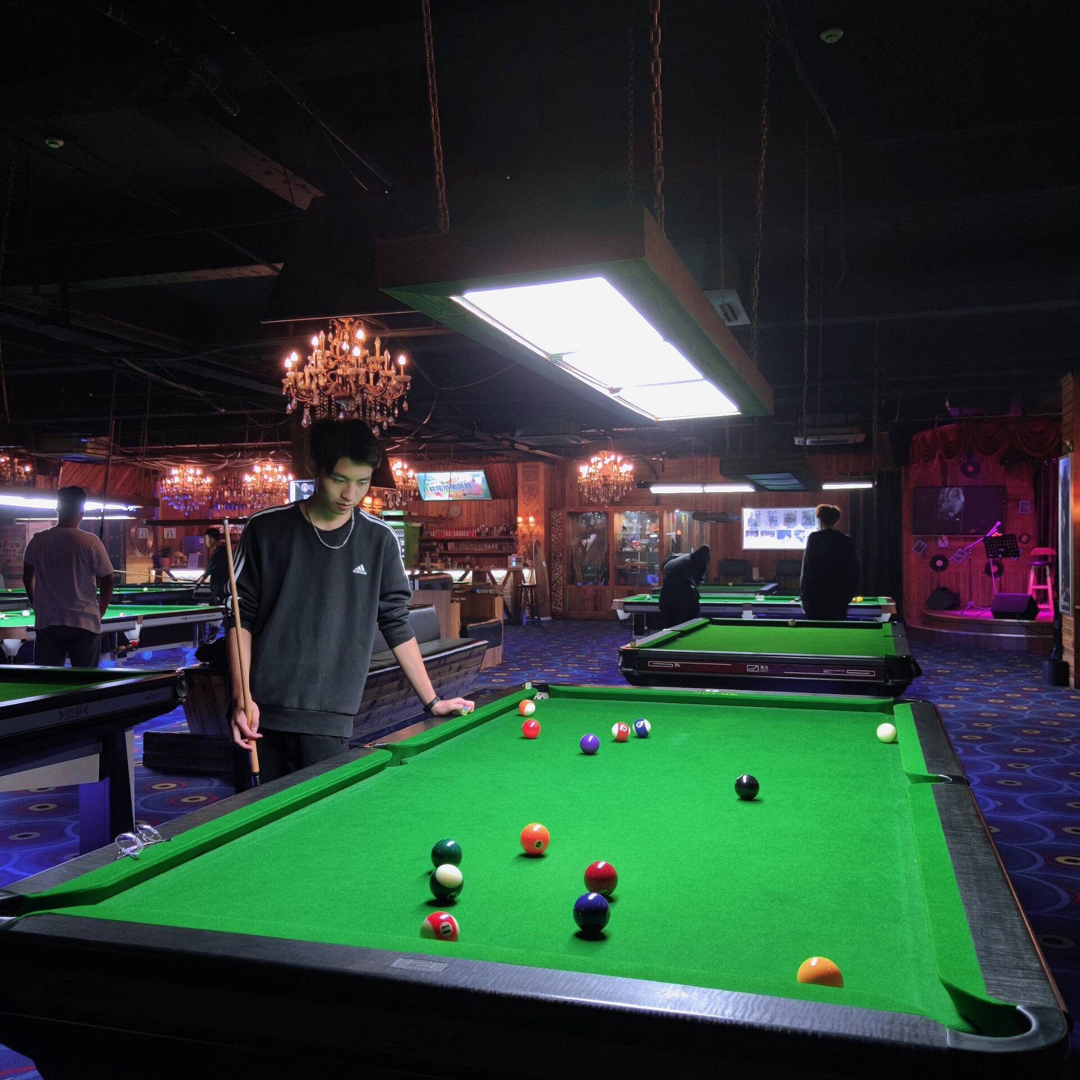
Introduction
Because we have learned a lot about the sports related content of the sphere, I have done a lot of small ball collision related projects before, and I also like to play billiards. When playing billiards in the resident hall, I was inspired that I can make a small project of playing billiards. This is a challenging and interesting idea.

Slide 4
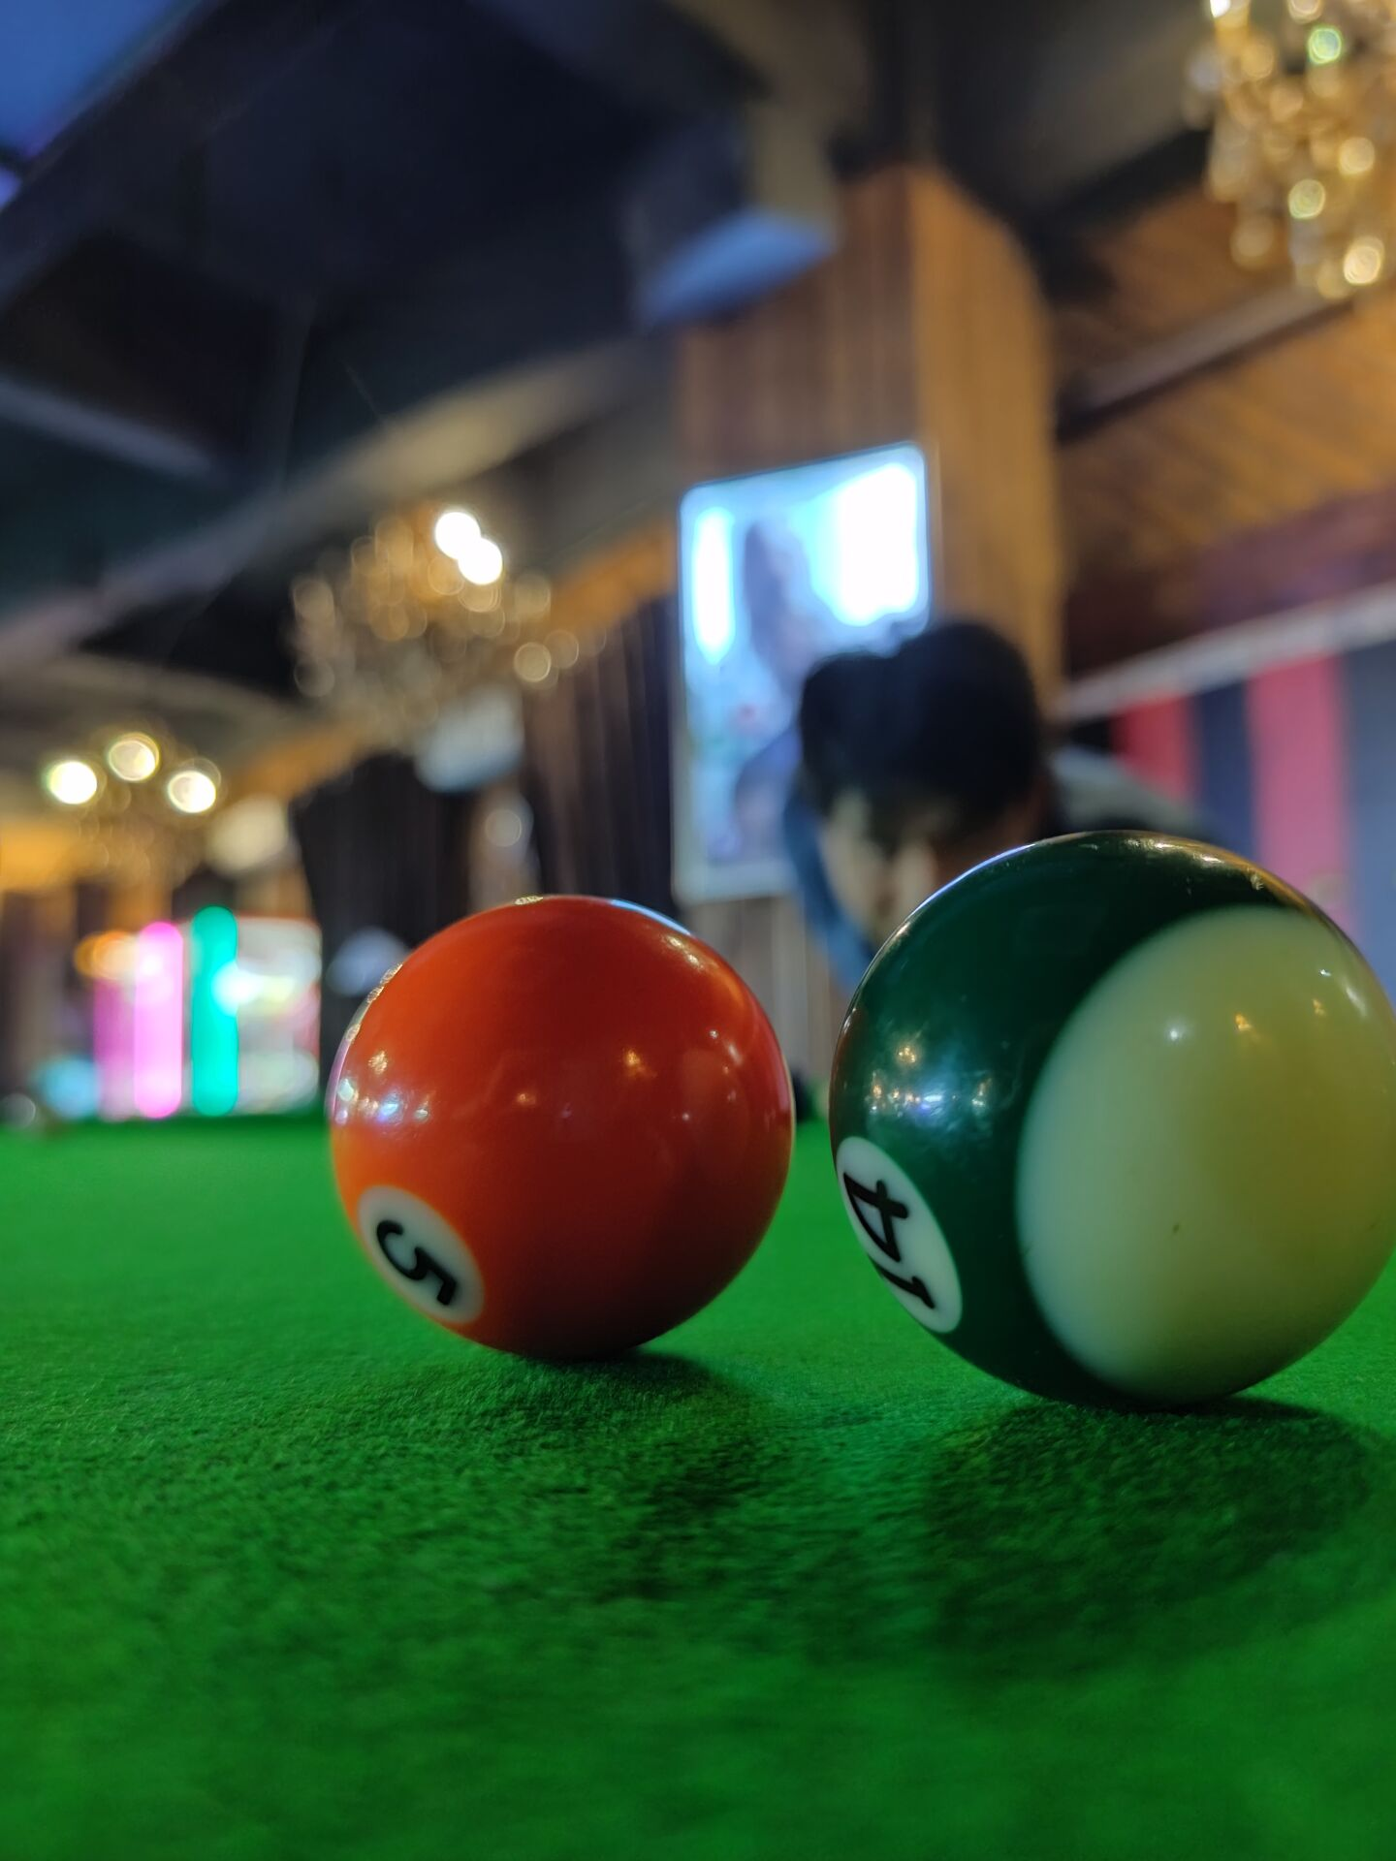
Introduction
You have 1 white ball and 15 balls of other colors balls. We can control the white ball to hit other balls
Score all the balls to win and get rewards!

Slide 5
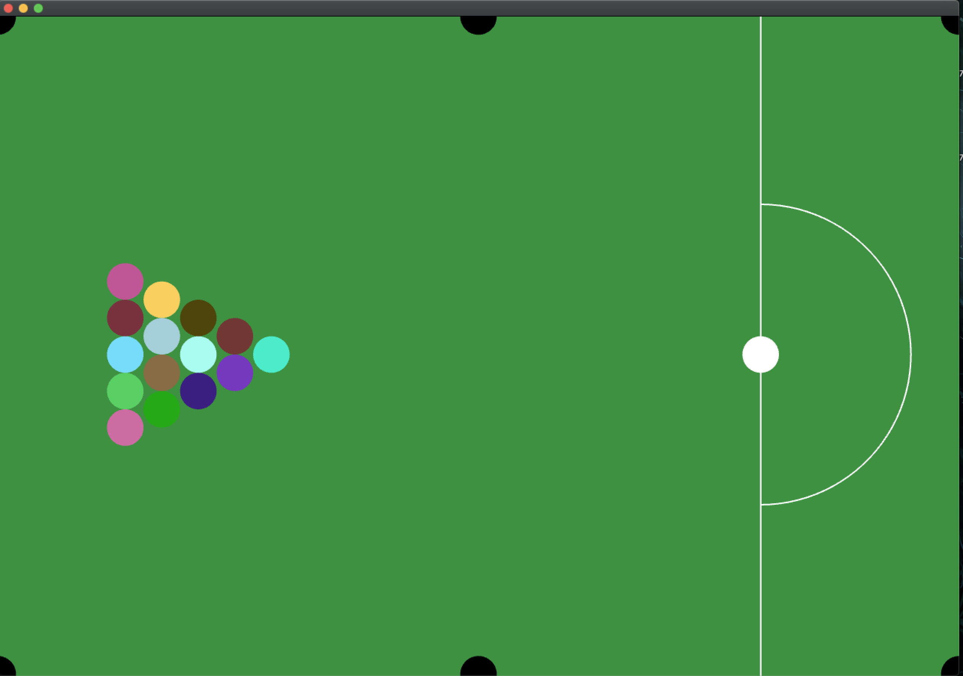
Show&Details
The size of the entire pool table and the ball are scaled down according to the real size and proportional to the window.

Slide 6
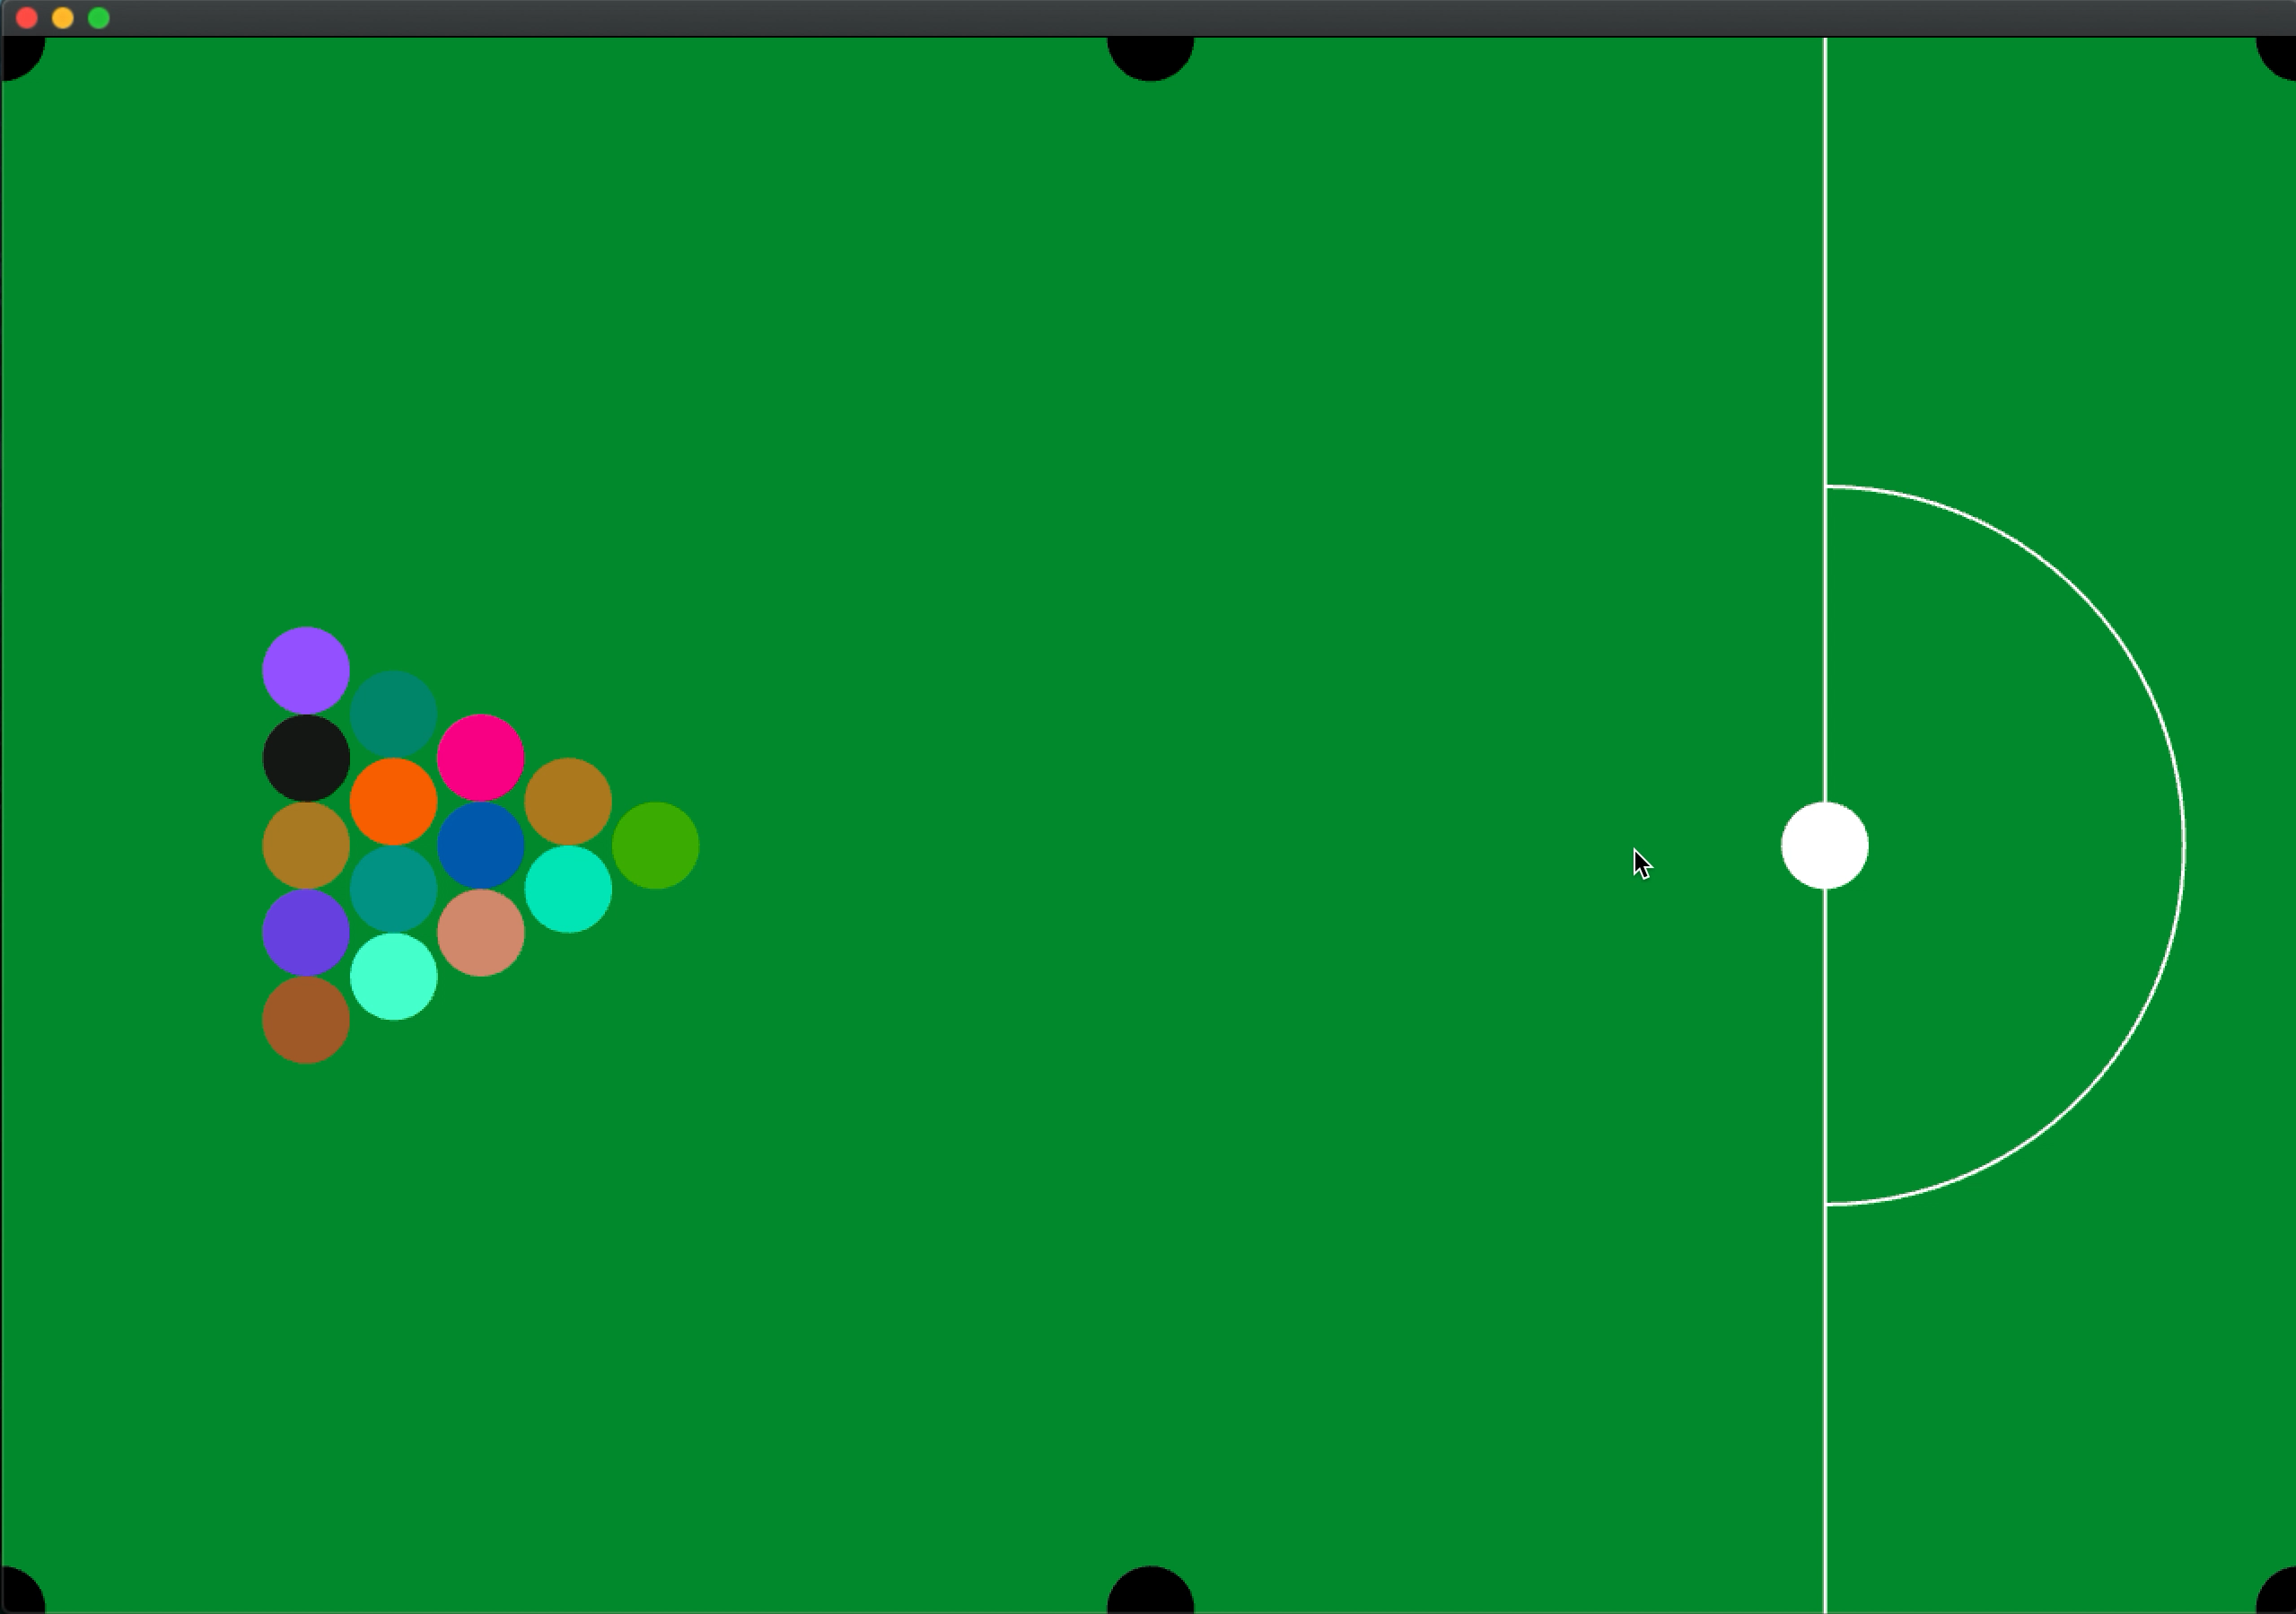
Show&Details
No cue required, we can control the direction and force by clicking the mouse. This makes it easier to control.

Slide 7
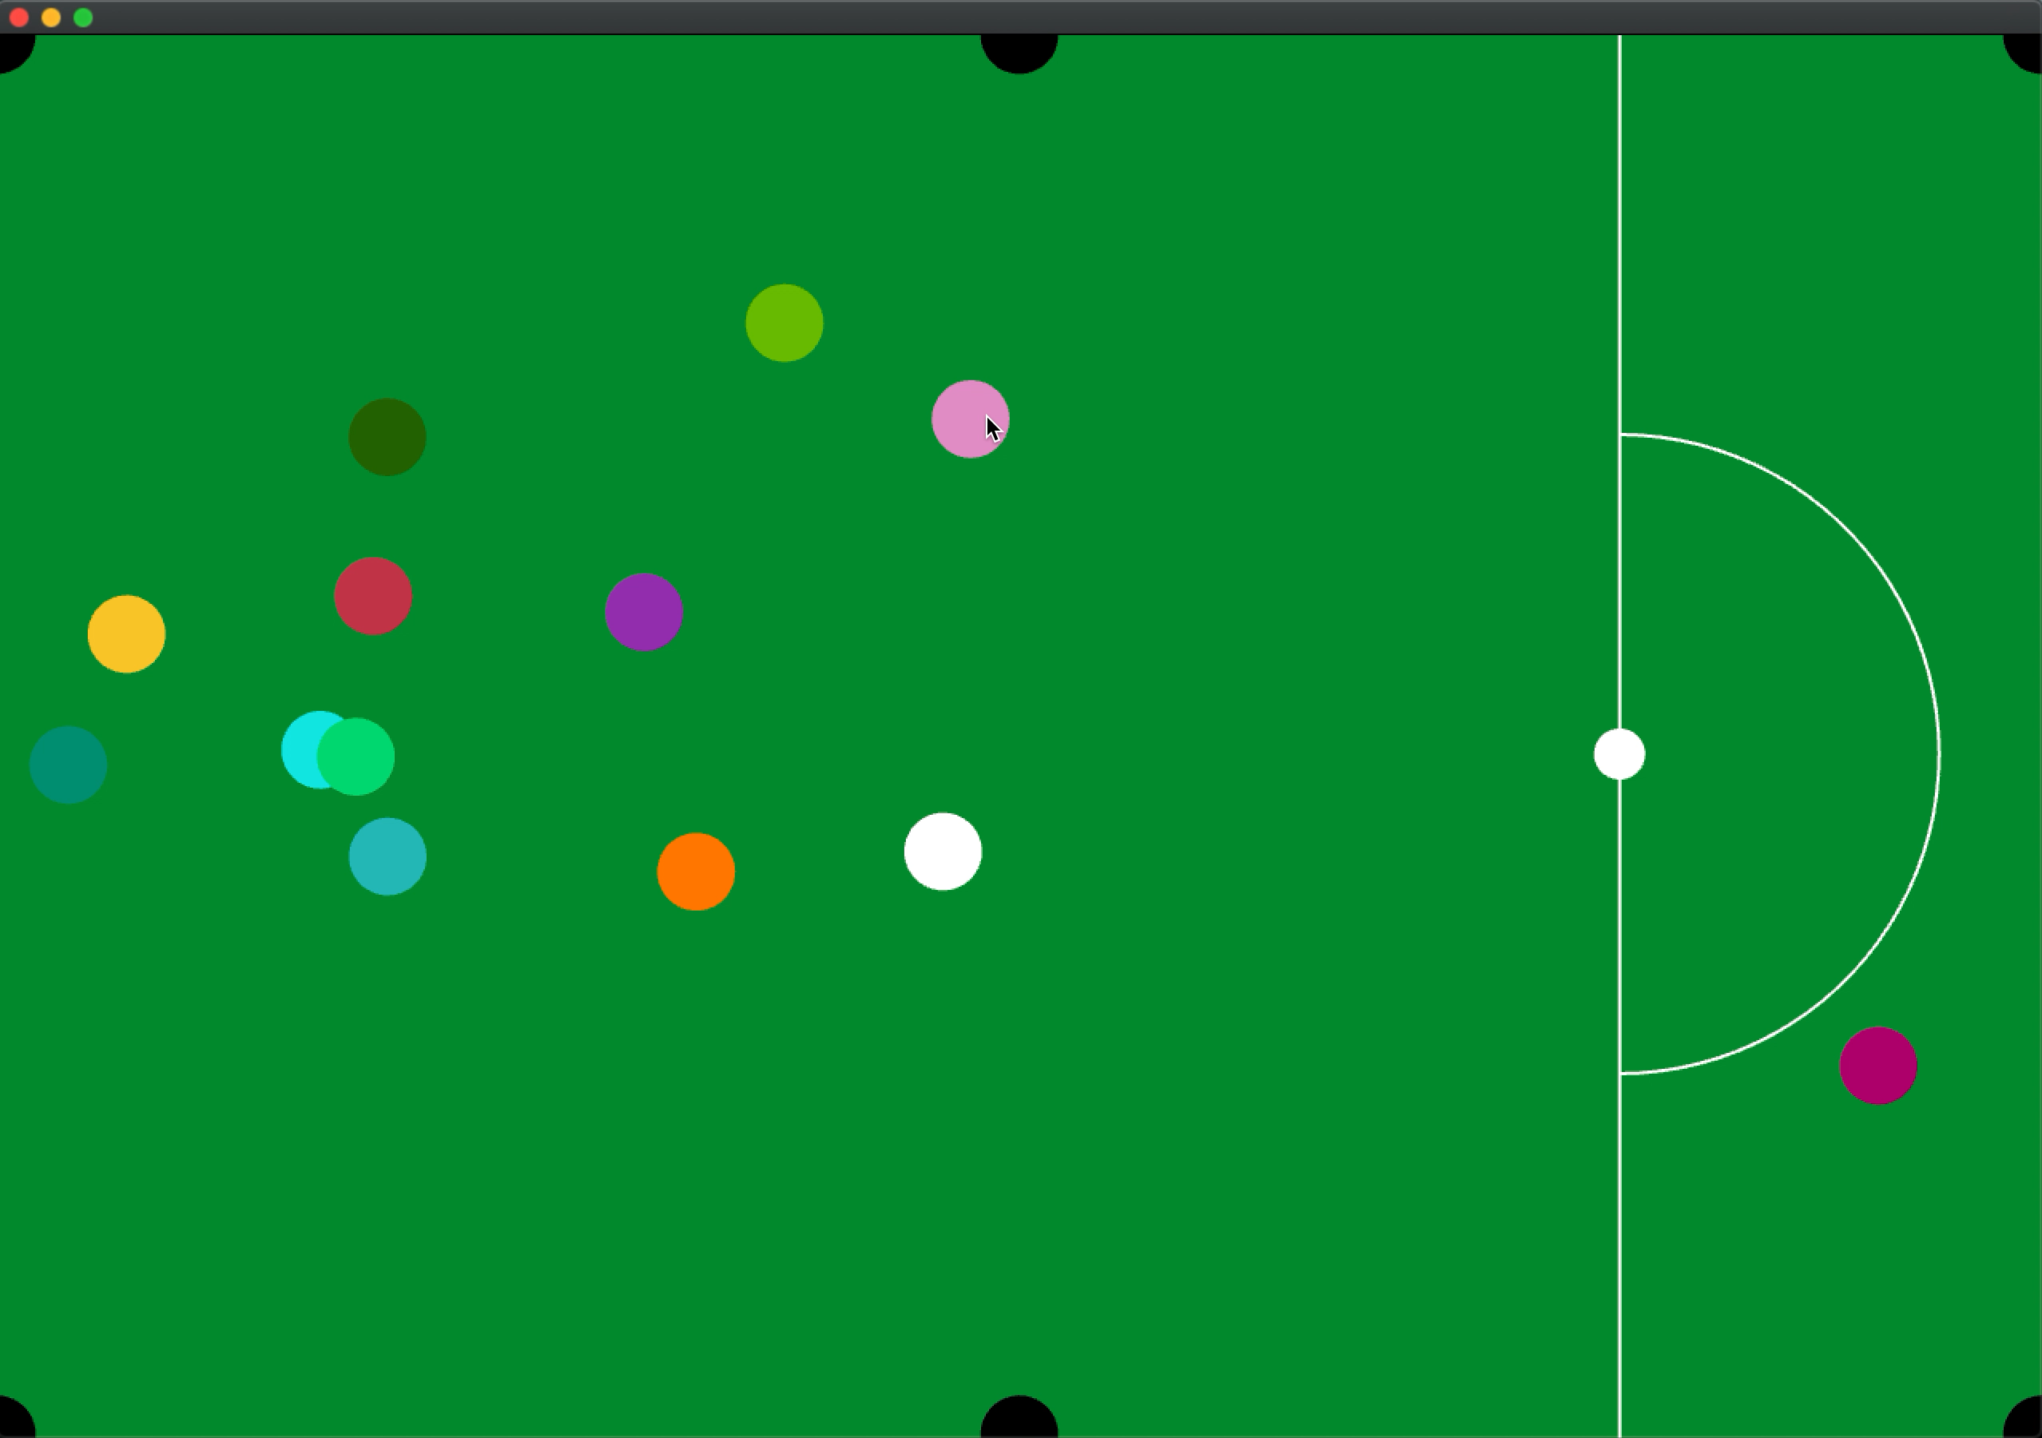
Show&Details
When you hit the colored ball to six black holes, the ball will go into the hole.

Slide 8
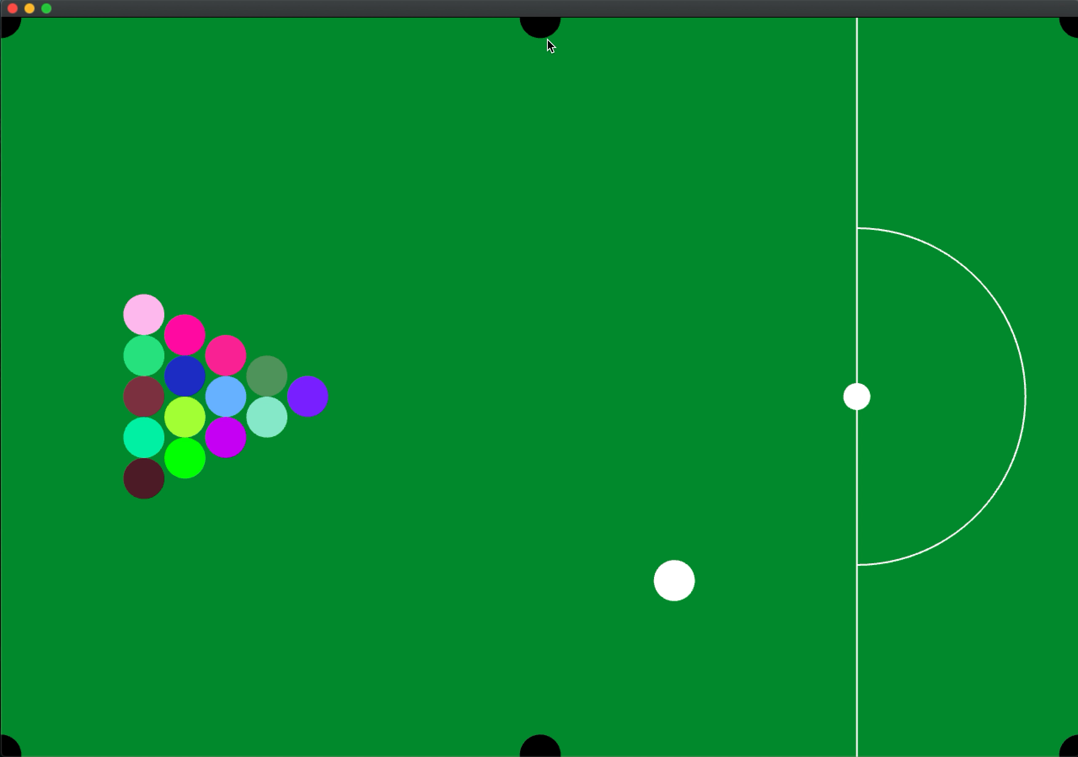
Show&Details
What should I do if the white ball is gone?
Don’t worry, it will return to its original position。

Slide 9
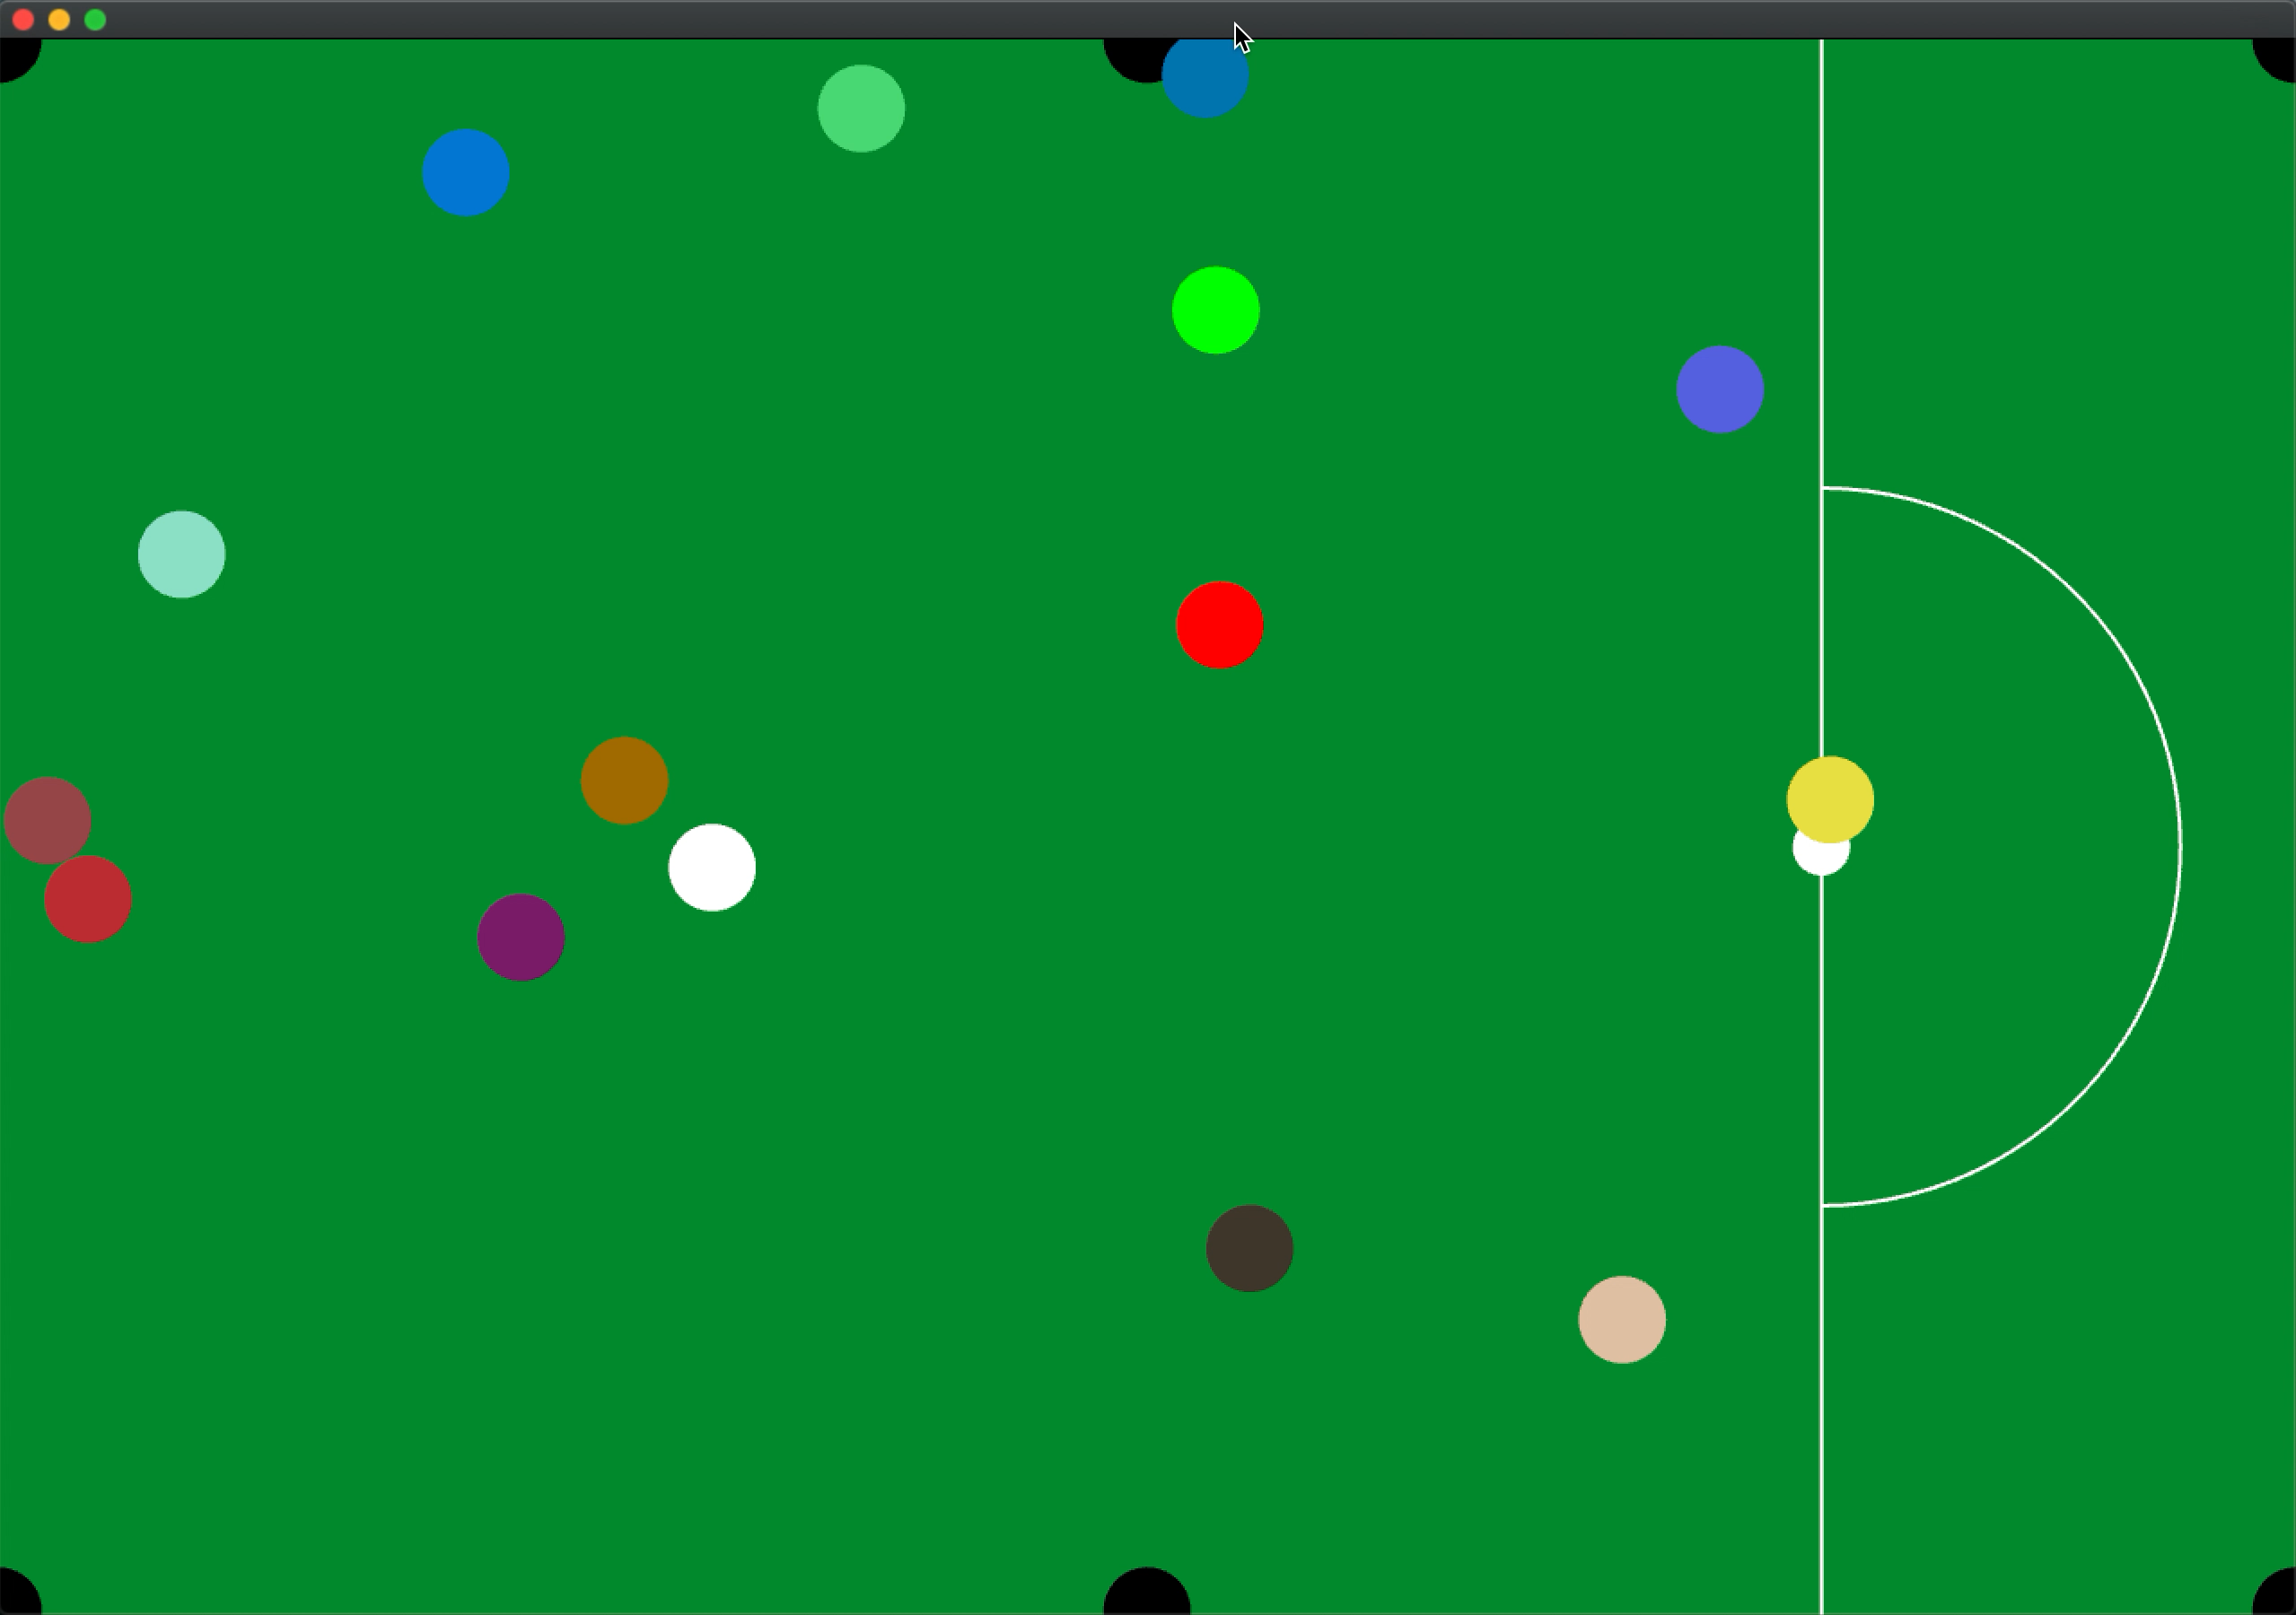
Show&Details
Press “R” to restart at anytime!

Slide 10
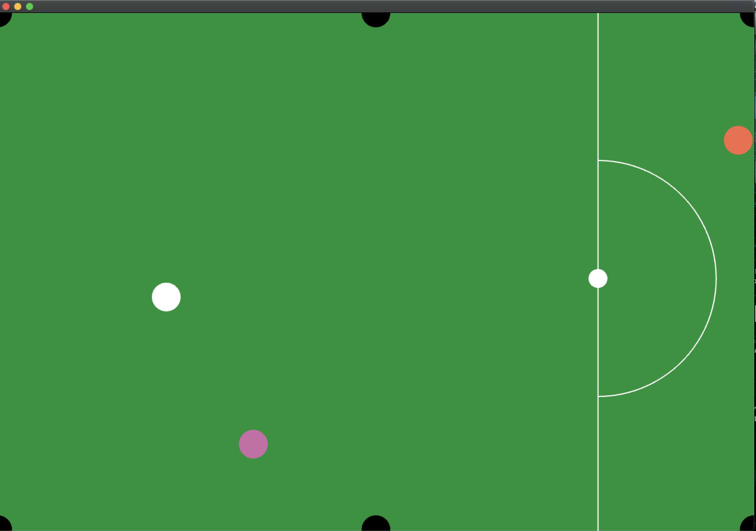
Show&Details
Do your best to score all the balls!

Slide 11
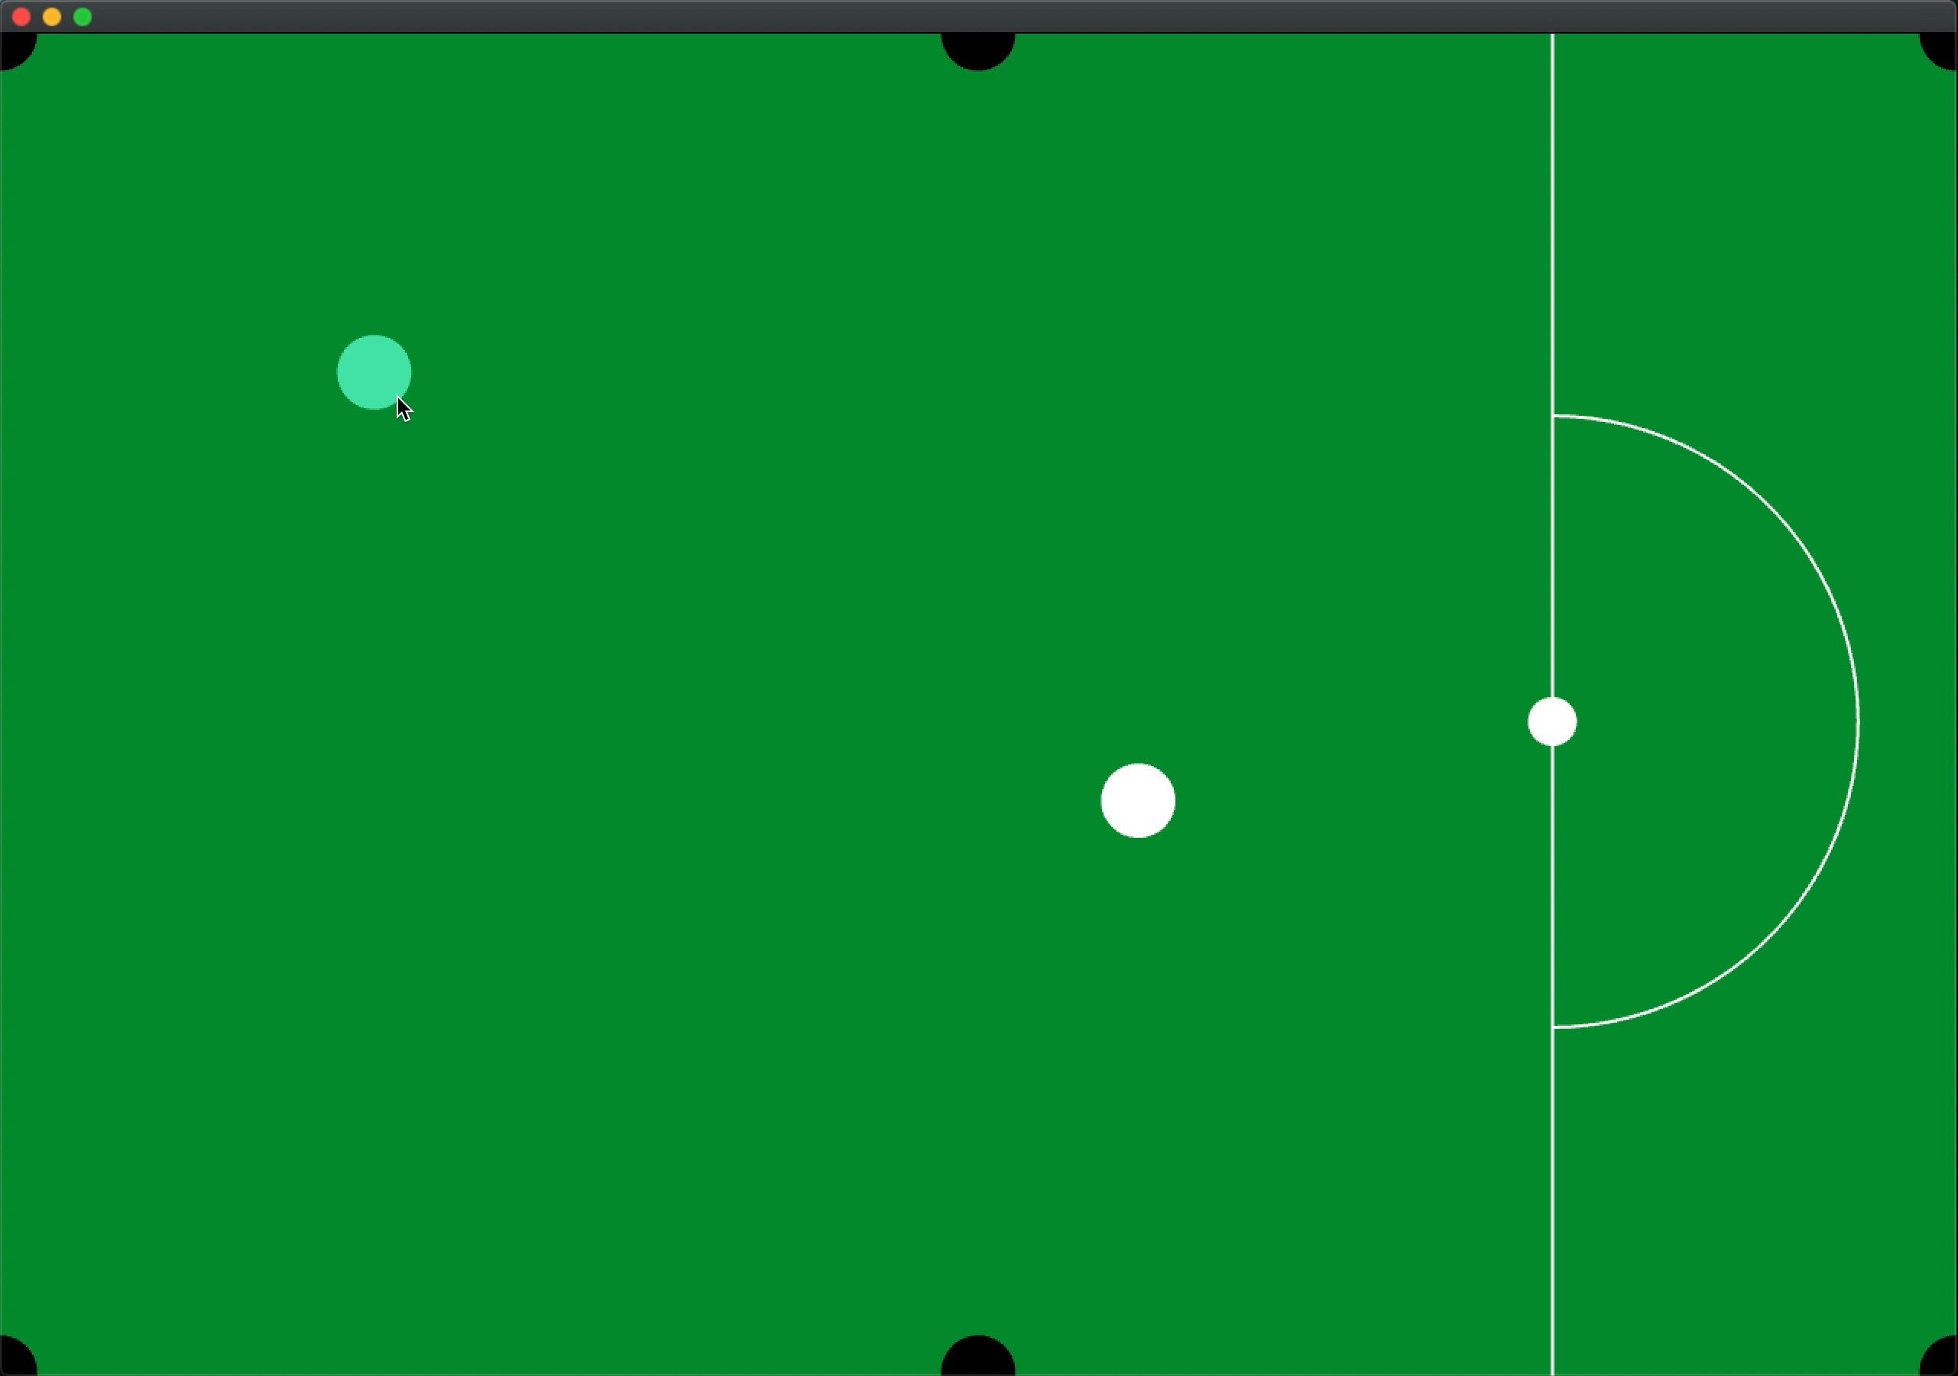
Show&Details
In the end, if you win the game, you will be rewarded with fireworks!

Slide 12
Summary
Have new experience and learn new knowledge in the challenge
I was struggling in the process, but I was very happy after making the final result. I felt a sense of accomplishment in creating new things.(Just imagine I am the best person in this game in the world and it makes me excited)
Maybe in the future I will improve it (such as 3D?)

Slide 13
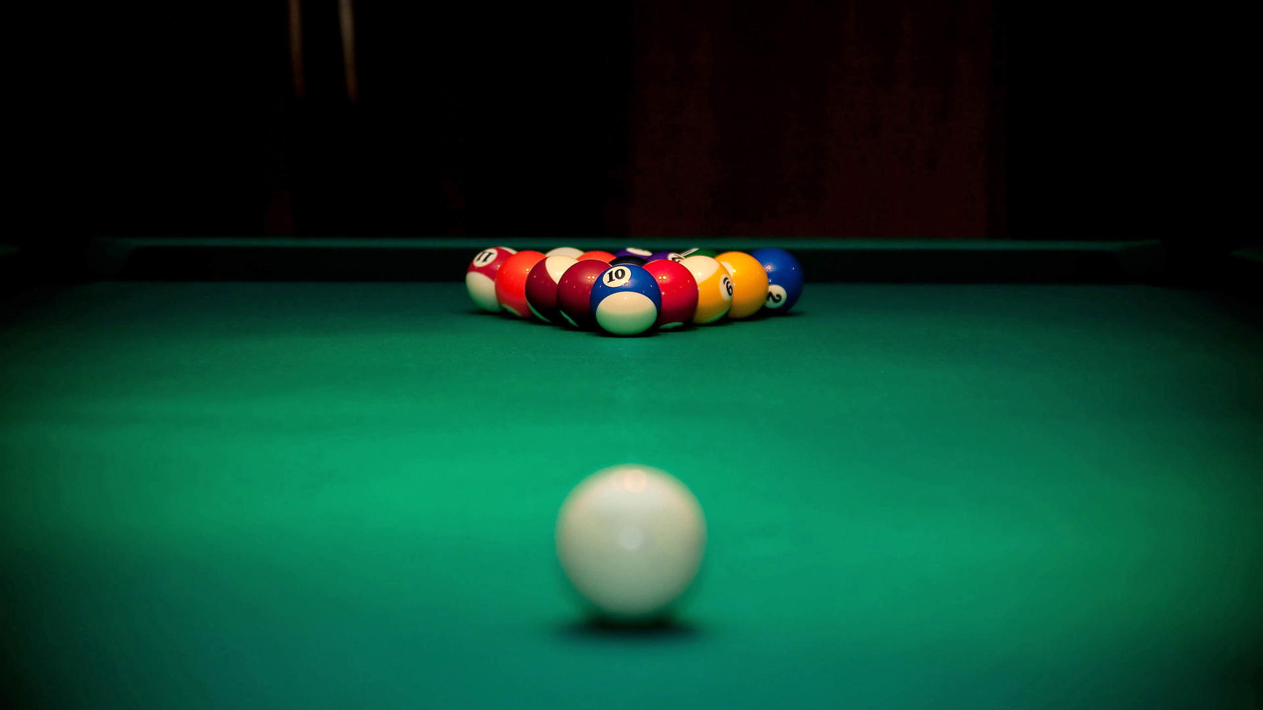
THANK YOU!

